Slide 1

MCTV LIMITED
ryan
Richard
Benit
qudus

Slide 2

introduction
This project was based around the business mctv limited
the idea of the project was each member was given a fake character and was given tasks based on this
Such as data base or website etc

Slide 3
Tasks
We spilt the work among each other
Ryan – github ,website , fact sheet and uml charts
Richard – data base
Benit-trello charts
Q- powerpiont

Slide 4
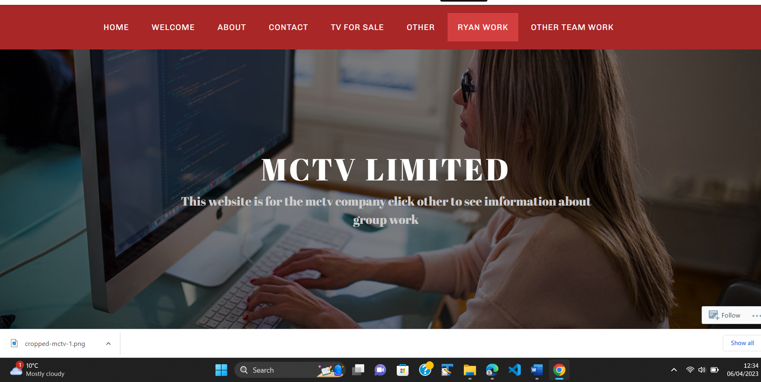
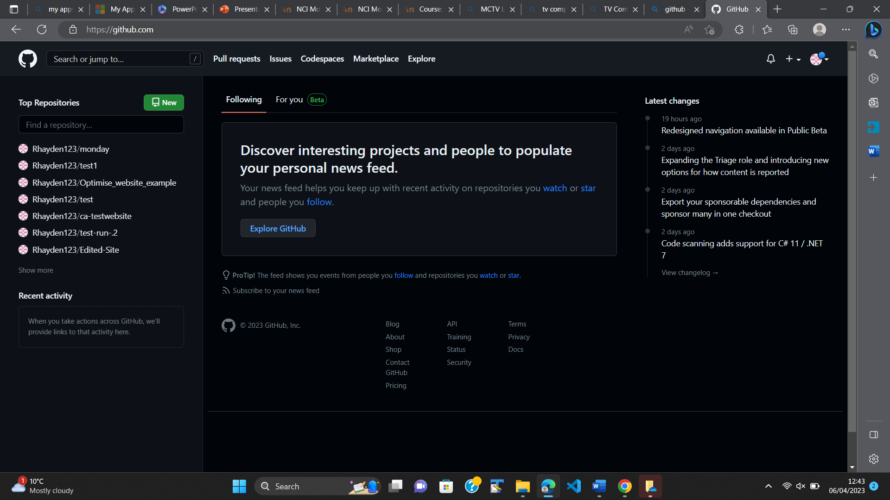
Our work

Slide 5
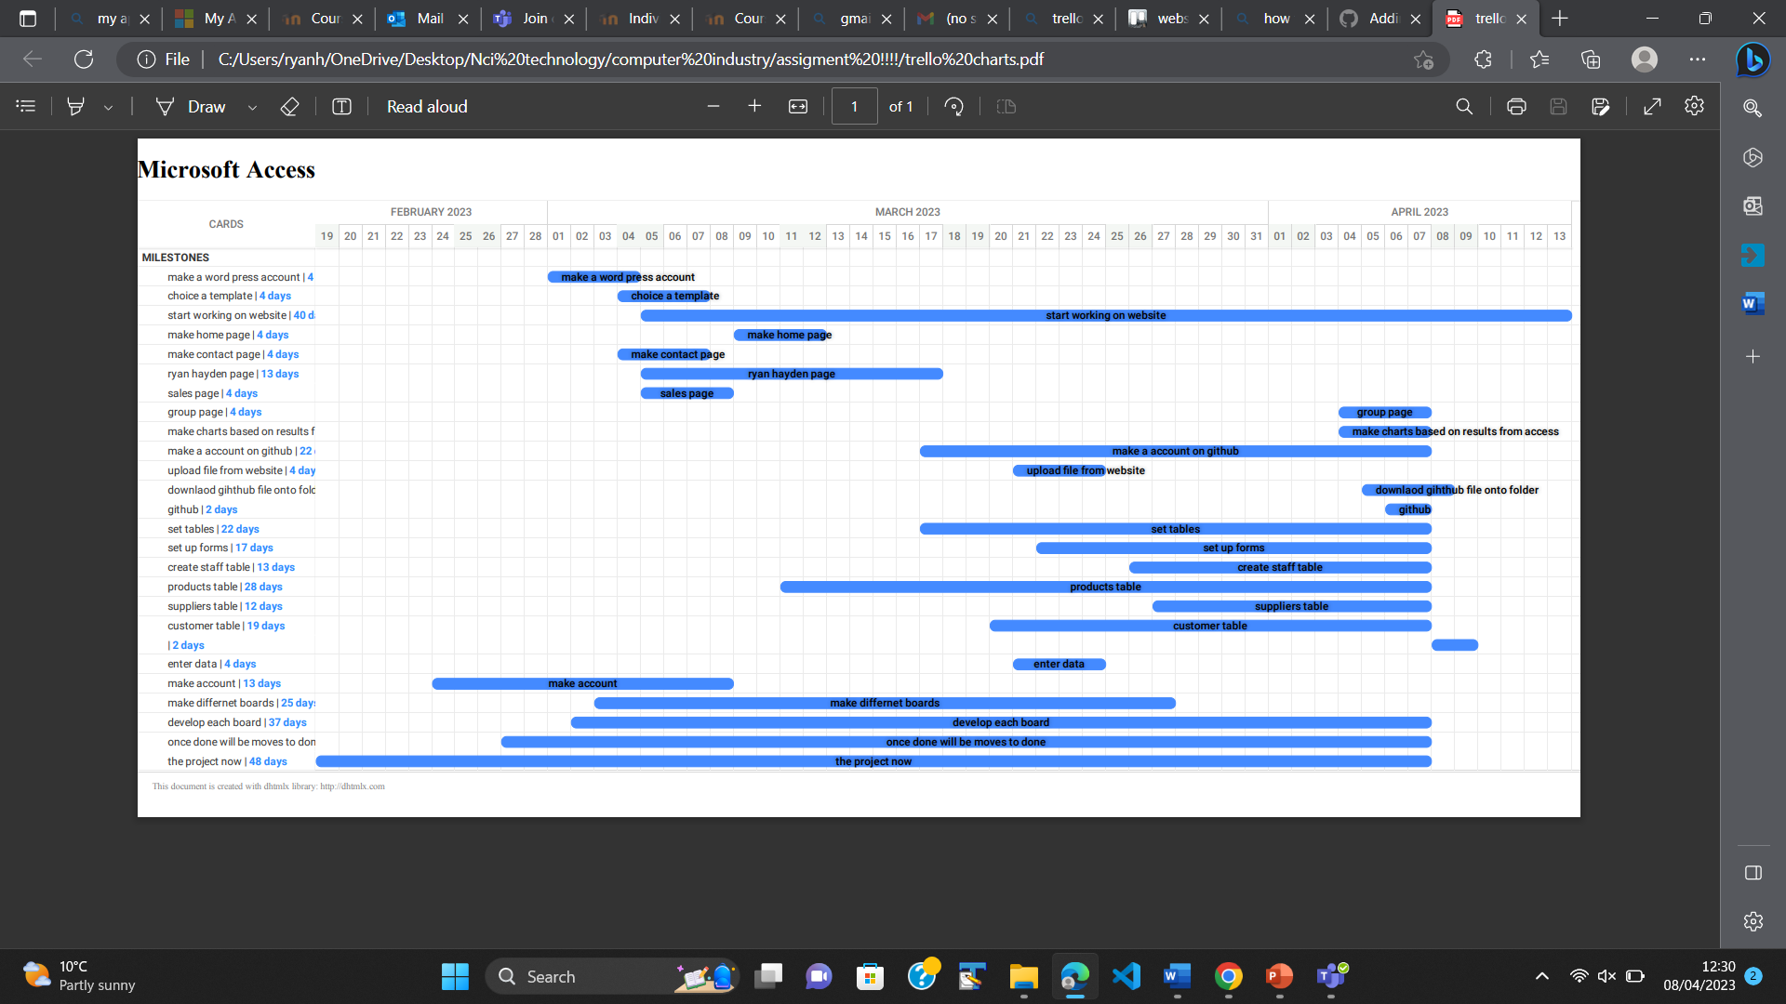
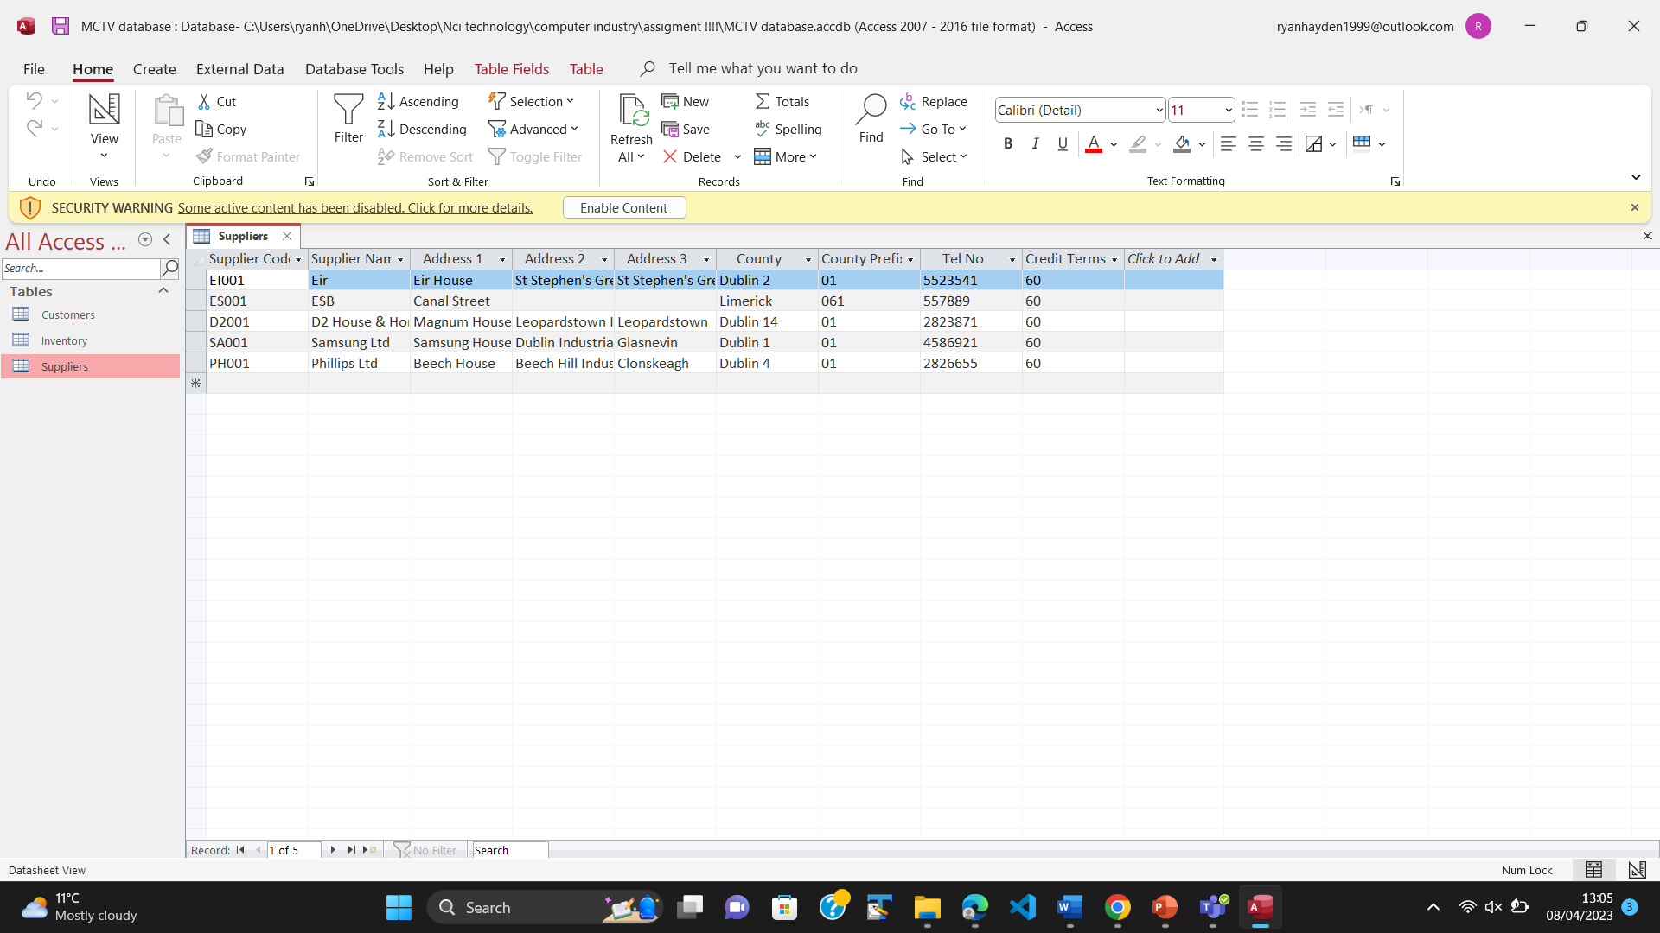
Our work

Slide 6


Logo ideas in brainstorming

Slide 7


Branding
So this is the logo
We based are project around a red colour and used ideas from other companies such as mtv

Slide 8
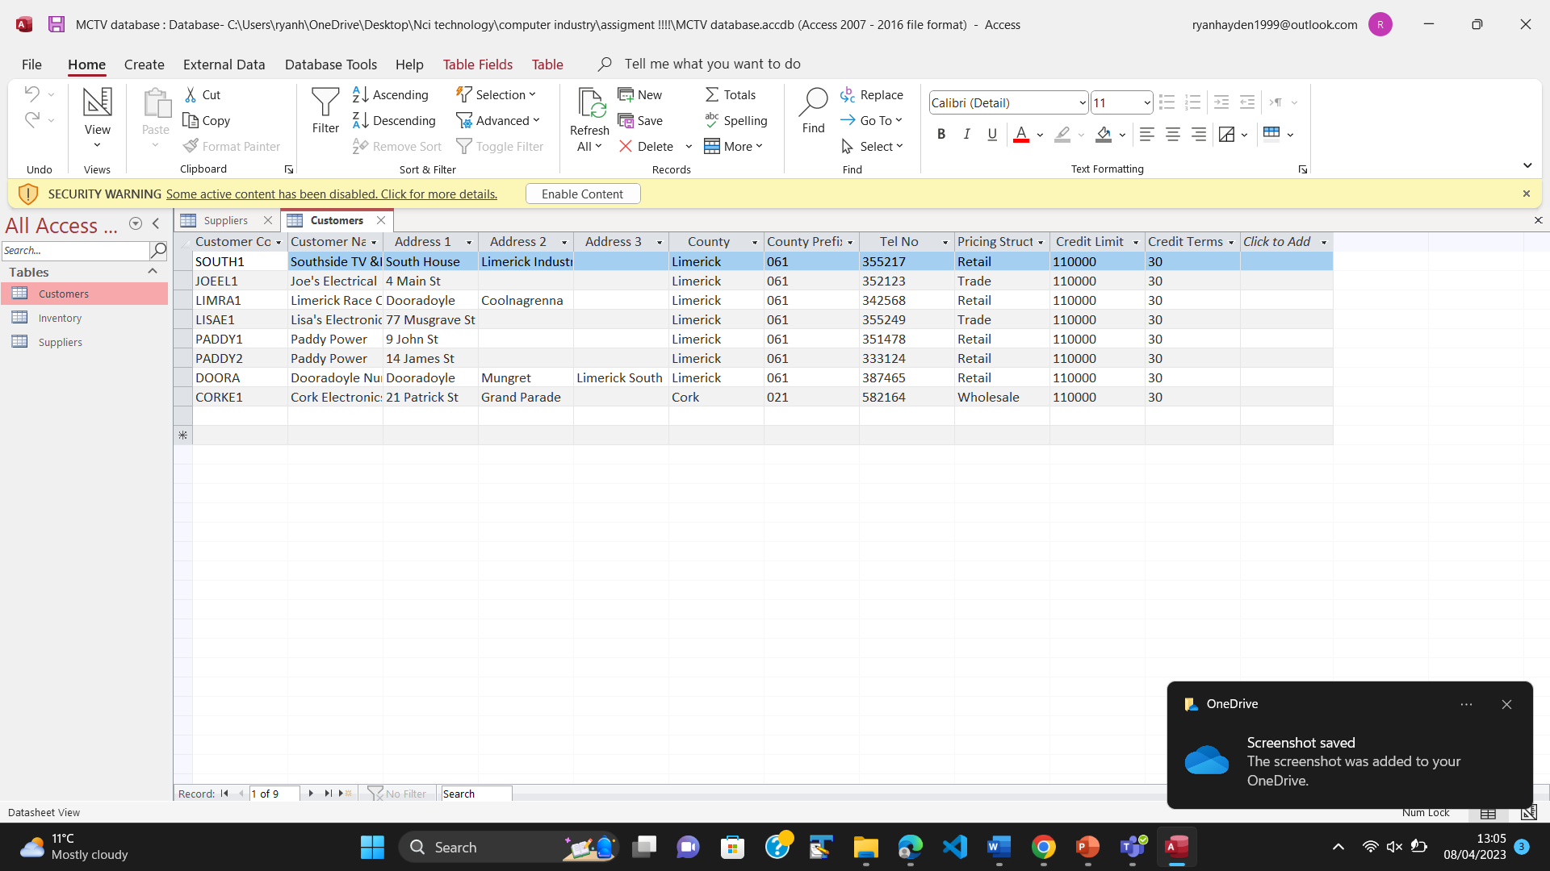
Over view of the database we made three different section of the database

Slide 9
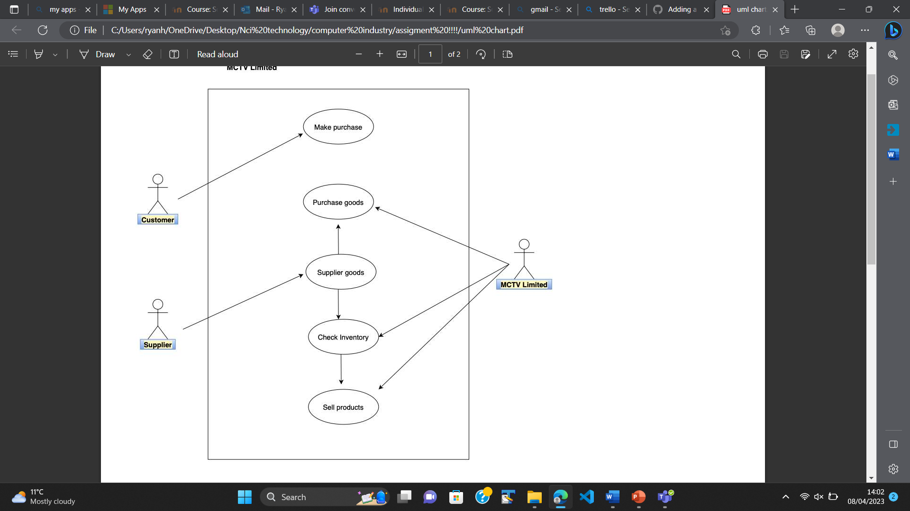
Overview of uml charts

Slide 10

User guide
Ryan – mark
I picked mark
with that I think the money should be invested into website and adverting, as I believe the money can be invested and develop the business and allow for online sales
With picking mark I was given the task of making website , github .

Slide 11

User guide
Richard =roberta
With this character Richard was given the task of the data base
Richard made three sections of the data and used the numbers from the Excel sheet and transfer it the access base

Slide 12

User guide
Benit = Liam
He made a Trello account and updated weekly
He updated the date when sections of the projects were due and when other team members finished their part

Slide 13

User guide
Qudus = derek
He made most of this PowerPoint which he used the data from other people’s work and used it to develop this
Powerpiont
He also did some research on the project

Slide 14
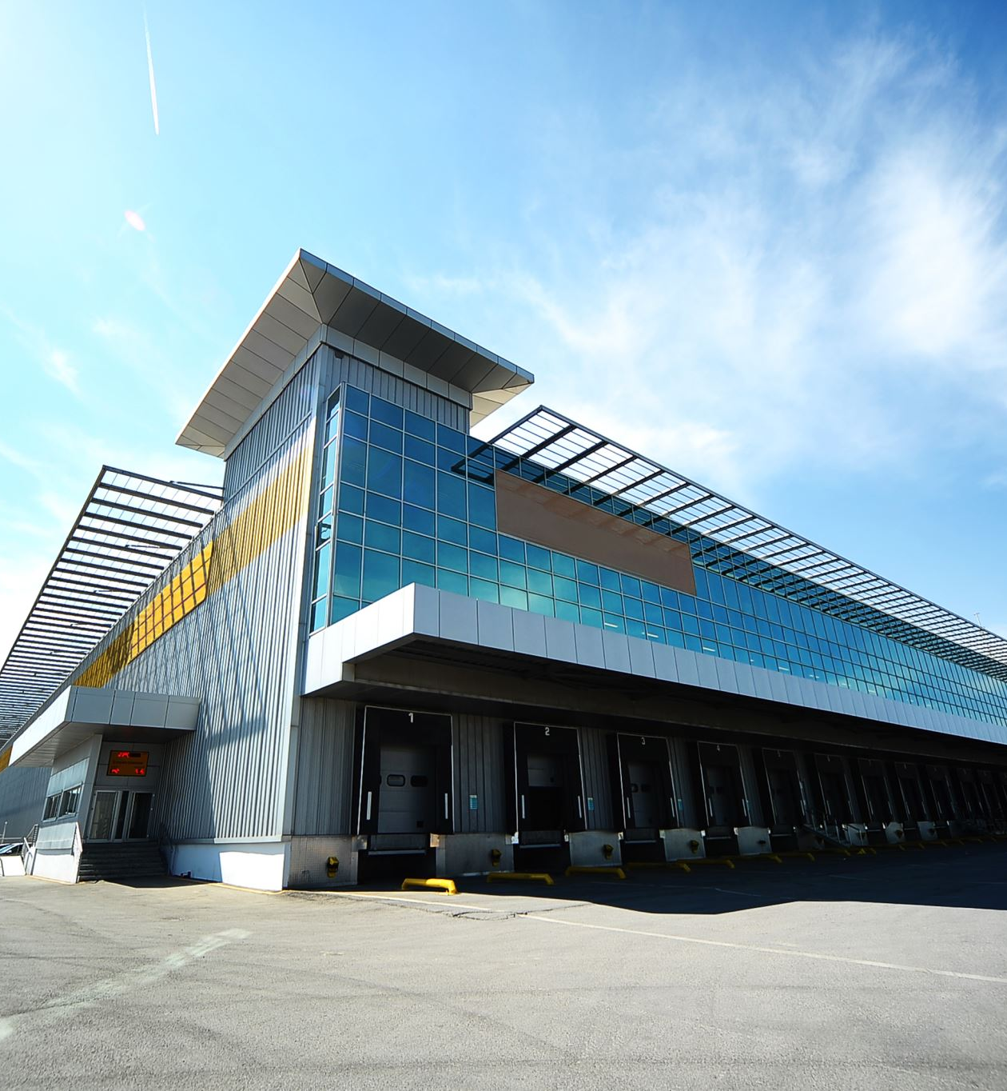
conclusion
The future development of the company.
So mctv business is a small limerick business that we think is missing out on a lot of opportunities we think the business should expand into other operations such as selling computers and develop the website more

Slide 15
conclusion
If we had to pick a character, we would choose mark
Opportunity
Larger audience
New market
Online profits
Cheap adverting

Slide 16

The end
Any questions

